Slide 1
GLOBAL WARMING
BASIC IT

Slide 2
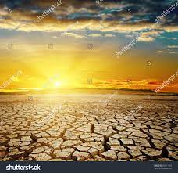
WHAT IS GLOBAL WARMING
Global warming as we know is an increase in the temperature of Earth’s atmosphere i.e. the
Earth gets hotter.
The Scientific community believes that climate like Global warming have occurred throughout the Earth’s history and will continue to occur in the future

Slide 3

FACTORS RESPONSIBLE FOR GLOBAL wARMING
There are many responsible fro GLOBAL WARMING. Some of them
are as follows -
Release of Chloro-Fluoro carbons (CFCs) into the atmosphere.
Deforestation
Pollution
Over exploitation of resources
Urbanization

Slide 4
Result of modernizatION
MEASURES TO CONTROL GLOBAL
WARMING
Use of eco – friendly fuels like CNG and
LPG
Planting more trees
Reuse, replenish and recycle
Judicious use of resources
Use alternative sources of energy
Impose strict laws by the Government to
curb Global Warming

